Slide 1
Access to Financial Services in Haiti
A Machine Learning Approach

Slide 2
Contents of This Template
Here’s what you’ll find in this Slidesgo template:
A slide structure based on a presentation for a meeting, which you can easily adapt to your needs. For more info on how to edit the template, please visit Slidesgo School or read our FAQs.
An assortment of illustrations and photos that are suitable for use in the presentation can be found in the alternative resources slide.
A thanks slide, which you must keep so that proper credits for our design are given.
A resources slide, where you’ll find links to all the elements used in the template.
Instructions for use.
Final slides with:
The fonts and colors used in the template.
A selection of illustrations. You can also customize and animate them as you wish with the online editor. Visit Storyset to find more.
More infographic resources, whose size and color can be edited.
Sets of customizable icons: general, business, avatar, creative process, education, help & support, medical, nature, performing arts, SEO & marketing, and teamwork.
You can delete this slide when you’re done editing the presentation.

Slide 3
Agenda
01
02
03
04
Introduction
Goal of the Project
Problem
Goals
Methodology
EDA
Describing the process of our project
Providing insights about the data
Recommandations
05
Model
06
Comparisons of the models

Slide 4
01
Introduction
This situation has happened to me multiple times. I had no cash on me but in my mobile wallet and wanted to buy something on the streets from a local merchant. He said he can’t sell me because he doesn’t have a mobile money account to receive the money.
I wondered why it was so difficult to implement these new payment methods in Haiti.
In Haiti, it is clear that the majority of the population is financially excluded. Do the reliable and responsible providers in Haiti (BRH, Commercial banks, cell phone operators) have difficulty targeting the people in Haiti?

Slide 5
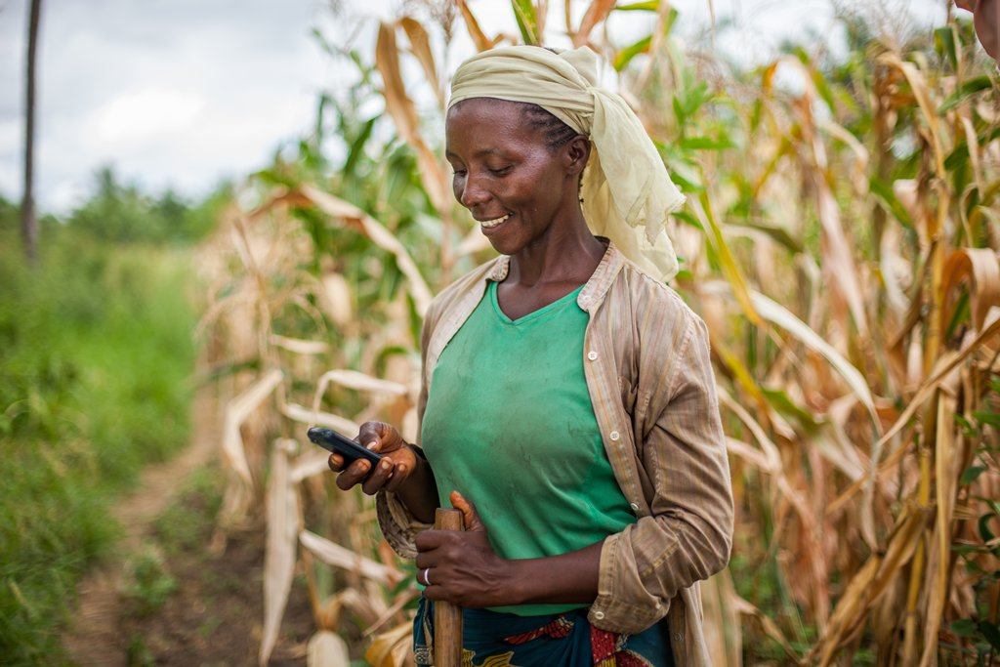
According to the FinScope 2018 survey, approximately 11% of Haitians have access to banking services; 33% turn to decentralized financial services and 11% use unregulated financial services.

Slide 6
Goal of the Project
The objective of this project is to determine if machine learning algorithms can help classify individuals in Haiti.
Financial Services providers can use the model’s prediction for data-driven decisions :
On Strategies like boosting and promoting to better target their audience like implementing social programs for financial inclusion
Developing better financial products for their potentials clients based on demographics and socio-economics drivers .

Slide 7
Target Audience
The target audience of this project is the Central Bank, the commercial banks , MNO’s ,IMF’S and other NGO’s in Haiti.

Slide 8

Data Source
The data we use is from a survey on 4269 people in Haiti about made by Finmark trust in collaboration with Group Croissance and USAID.

Slide 9
Methodology
Collect
Cleaning And Analysis
Modeling
Recommandations
Collecting Data from Finmark Trust
Cleaning Data and EDA using Python Pandas and Numpy
Building a Machine Learning Classification Model with Python
Providing Recommandations to different actors in the financial sectors

Slide 10
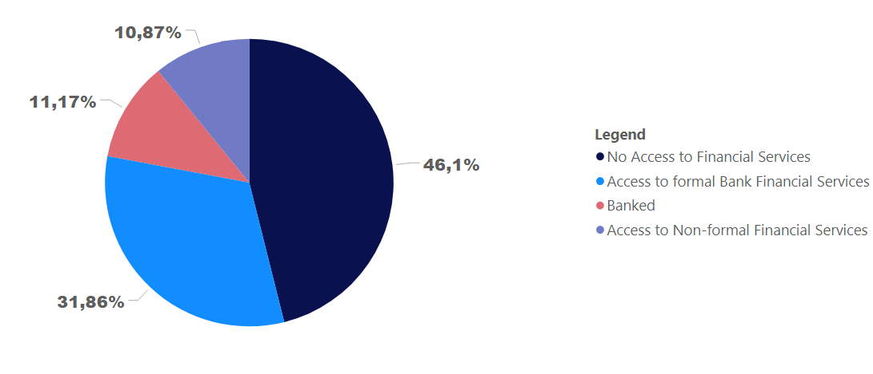
Access to Financial Services.

Slide 11
Keys Numbers
46.1%
Financially Excluded.
65.4%
76.9%
70.1%
Had No schooling
Are Jobless
Earns less than 46 $ a month

Slide 12
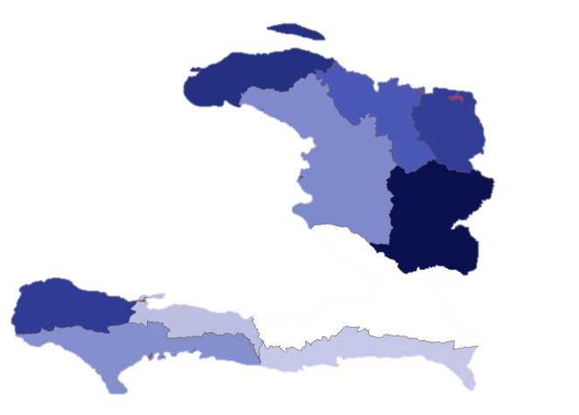
Financially Excluded
Nord-Ouest
2nd state with the most people exclude
Centre
State with the most people excluded
Grand’Anse
3rd state with the most people exclude

Slide 13
Supervised Machine Learning

Slide 14
Model Selection
I will select suitable metrics that are appropriate for multi-class classification problems and have been used for similar tasks.
The metrics will be :
* accuracy score,
* recall score

Slide 15
Model Selection
The appropriateness of different models based on the task at hand, multi-class classification, We will take into account other parameters such as size, shape and other characteristics of the data, training speed.
The Classifier models we will try are :
Support Vector Machine
Random Forest Classifier

Slide 16
Features Selection
The features that will help me build my model is information about
In which State they live ?
Which documents they have (ID, passport, Birth cert)
Which communications device, they use or own
Access to Internet
Level of education
Income level
Do they receive or send Money?
Do they save Money ?
Do they Borrow Money ?

Slide 17
Model 1
Support Vector Machine
Accuracy
Recalll
Financially Excluded : 92,7%
Banked : 73,4 %
Formal banked services : 83,8 %
Non- formal financial Services : 71,2%
84,20 %
Percent of individual identified in a class that are actually part of the class
Percent of individual in a class that the machine identified in that class

Slide 18
Model 2
Random Forest Classifier
Accuracy
Recalll
Financially Excluded : 92,7%
Banked : 69.2 %
Formal banked services : 85,8 %
Non- formal financial Services : 66,2%
85,54 %
Percent of individual identified in a class that are actually part of the class
Percent of individual in a class that the machine identified in that class

Slide 19
Comparison of the two Models
Support vector Machine vs Random Forrest Classifier
Random Forest Classifier display the highest average score across the 5 folds but SVM has lowest variation in performance.
For imbalanced datasets such as ours, overall accuracy score is not always an appropriate measure. If an overwhelming number of examples are from one class even poor models can achieve high accuracy scores.
We will also rely on recall scores.

Slide 20
Conclusion
The purpose of this project was to develop a model to predict the level of financial inclusion among a sample of survey respondents based on socio-economic, demographic drivers.

Slide 21
Recommandations to the Private Sector
Accept new payment methods at their point of sale such as mobile money, online payment

Slide 22
Recommandations to the Financial services providers
Facilitate the process of implementing points of service in areas where there are the most people not included.

Slide 23
Recommandations to the STATE
Speed up with national financial education plan

Slide 24

Conclusions
Venus has a beautiful name and is the second planet from the Sun:
Here you can enter one of your conclusions
Here you can enter one of your conclusions
Here you can enter one of your conclusions

Slide 25
Thanks
Do you have any questions?
addyouremail@freepik.com
+91 620 421 838
yourcompany.com

Slide 26
Alternative Resources
Vectors
Cashback landing page and buyer
Cashback landing page earn rewards
Indian rupee bills exchange
Banking icons
Photos
Businesswoman during a professional meeting with her teammates
Portrait of three businesswomen indoors
Smiley professional businesswoman with glasses doing a presentation

Slide 27
Resources
Did you like the resources on this template? Get them for free at our other websites.
Vectors
Flat design cash on delivery concept
Cashback concept - landing page
Photos
Businesswoman with glasses during a meeting presentation with her peers
Professional businesswoman with glasses during a meeting with her colleagues
Businesswoman during a professional meeting with her teammates
Businesswoman with glasses during a meeting presentation

